Slide 1

5th Floor, Usnaz Tower, Church Landing Rd, near Medical Trust Hospital, Pallimukku, Kochi, Kerala 682016

Slide 2
Looping statements

Slide 3
In Python, loops are used to execute a block of code repeatedly until a certain condition is met. There are two main types of loops in Python: for and while.
Type of loops in python
For loop
While loop
Nested loop

Slide 4
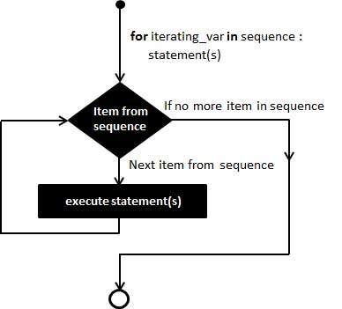
For loop
for loop: It is used to iterate over a sequence of elements a fixed number of times. The syntax of a for loop varies depending on the programming language, but it typically includes a variable that is initialized, a condition to be met, and an expression to update the variable at each iteration.

Slide 5
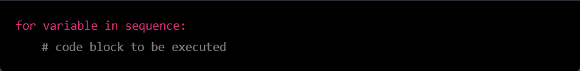
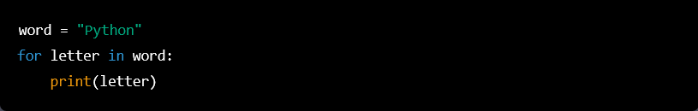
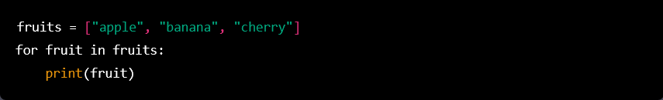
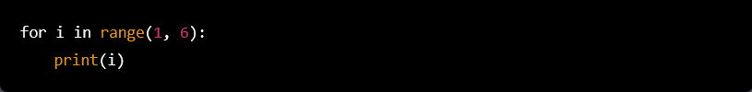

Slide 6
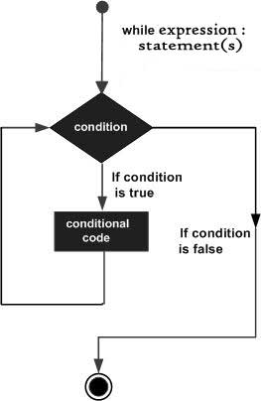
While loop
A while loop is used to execute a block of code repeatedly as long as a certain condition is true. The basic syntax of a while loop is as follows. .

Slide 7
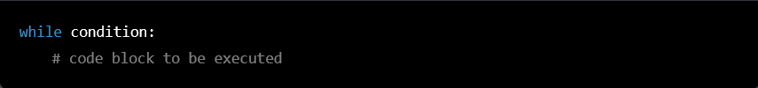
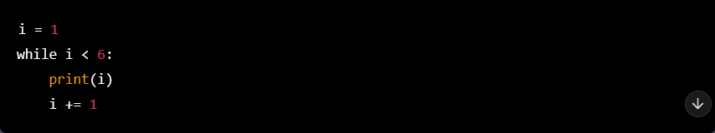

Slide 8
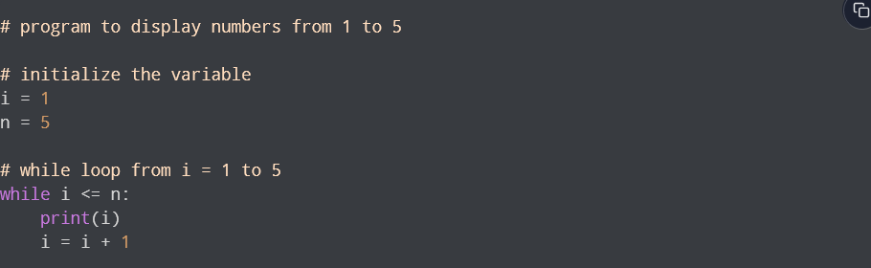

Slide 9
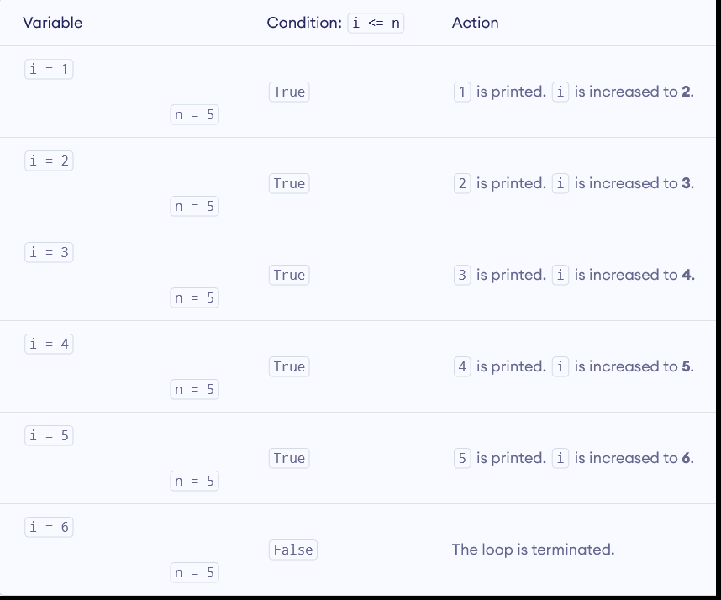

Slide 10
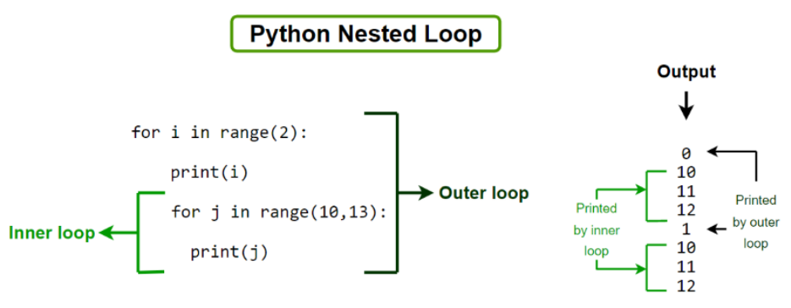
Nested loop
In Python programming language there are two types of loops which are for loop and while loop. Using these loops we can create nested loops in Python. Nested loops mean loops inside a loop. For example, while loop inside the for loop, for loop inside the for loop, etc.

Slide 11
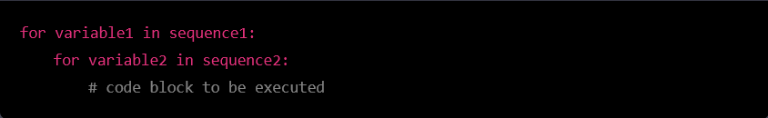
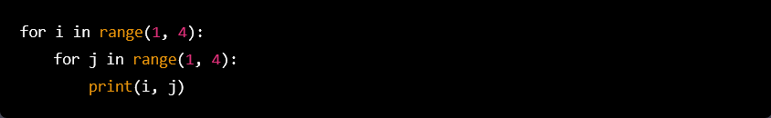
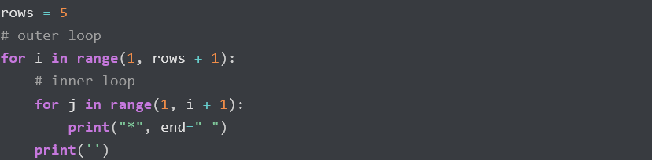

Slide 12
